Slide 1

Conceptual session on
Functions, Objects & Apply JavaScript
Fahim Ahammed Firoz
Web Instructor, Programming Hero

Slide 2
JavaScript Functions
JavaScript Objects
Table of Contents
let and const
Points for discussion
Object VS Array
JavaScript switch case break and default
Apply JS concepts

Slide 3

JavaScript Functions
A JavaScript function is a block of code that perform a particular task.
To work with functions we need to know 02 (two) things-
Declaring a Function
Calling a Function

Slide 4
Declaring a Function
The syntax to declare a function is-
function nameOfFunction () {
// block of code
}
// example
function greet () {
console.log(“Hello everyone”);
}

Slide 5
Calling a Function
In the above program, we have declared a function named greet(). To use that function, we need to call it.
Here’s how you can call the above greet() function.
// calling a function
greet();

Slide 6
Working of a Function in JS
function greet () {
console.log(“Hello everyone”);
}
greet();
// code
https://www.programiz.com/javascript/function

Slide 7
Function Parameters
A parameter is a value that is passed when declaring a function.
function greet (name) {
console.log(“Hello ”, name);
}
greet( “Ananta Jalil” );
// code
function sum (num1, num2) {
console.log(num1+num2);
}
sum ( 5, 7 );
// code

Slide 8
Function Return
The return statement can be used to return the value to a function call.
The return statement denotes that function has ended.
function sum (num1, num2) {
console.log (num1+num2);
}
sum ( 5, 7 );
// code
return
console.log( sum( 5, 7) );

Slide 9

Why functions?
You can reuse code: Define the code once, and use it many times.
You can use the same code many times with different arguments, to produce different results.

Slide 10
Exersice-1
Write a function to check odd or even number.
You need to do it in 2 ways- has return and no return.
Input | Output
2 | Even
9 | Odd
104 | Even

Slide 11
Exersice-2
Write a function which will take 3 integers and return the largest number.
You need to do it in 2 ways- has return and no return.
Input | Output
2, 3, 1 | 3
2, 5, 7 | 7
6, 5, 8 | 8

Slide 12
Let & Const
‘let’ is a signal that variable may be reassigned.
Example:
let x = 30;
x = 50;
let age = 21;
age = age+1;
‘const’ means that the identifier can’t be reassigned.
Example:
const x = 30;
x = 50;
const age = 21;
age = age+1;

Slide 13
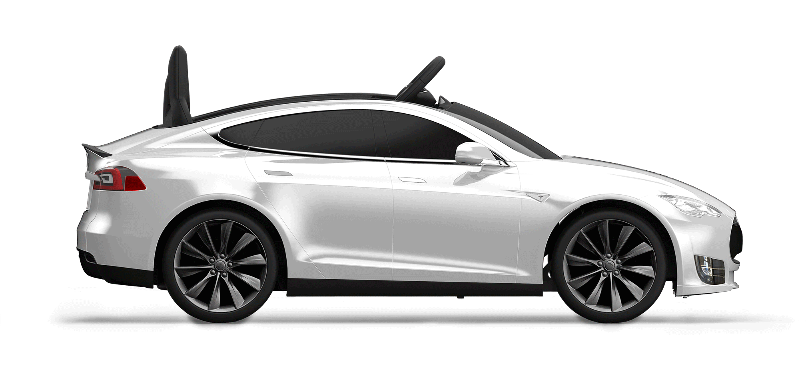
JavaScript Objects
In JavaScript, almost “everything” is an object.
brand = Tesla
model = 3
weight = 980kg
seating = 5 Adults
start()
drive()
break()
stop()
Object
Properties
Methods

Slide 14
JavaScript Objects
Objects are variables too. But objects can contain many values.
This code assigns many values (Tesla, 3, 980kg) to a variable named car:
var car = { brand: ‘Tesla’, model: 3, weight: ‘980kg’, seating: ‘5 Adults’, start()};

Slide 15
Array vs Object
Array | Object
const arr = [ 1, 3, 23, 56, 89 ]; | const obj = { name: “Laptop”, brand: “Apple”, price: 12000 }

Slide 16
Exersice-3
Write a program to find the total price of those product object.
{ name: “Laptop”, color: “black” , price: 12000 }
{ name: “Monitor”, color: “gray” , price: 5000 }
{ name: “Mobile”, color: “black” , price: 2500 }

Slide 17
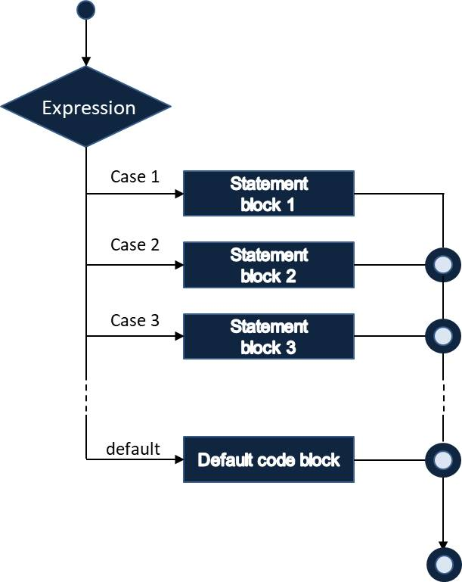
Switch-case
The switch statement is used to perform different actions based on different conditions.
Syntax:
switch (expression) { case x: // code block break; case y: // code block break; default: // code block }

Slide 18
Problem-1
Write a function that will take a radius of a circle and will return the area of circle. [ Hint: Area of Circle = $πr^{2}$]
Input | Output
5 | 78.54
7 | 153.94
3 | 28.27

Slide 19
Problem-2
Write a function that will take feet as the input parameter and will convert it into inch and will return the result in inch.
Input | Output
1 | 12
3 | 36
1.5 | 18

Slide 20
Problem-3
Write a function that takes input the total price of the products you bought and returns the net price calculated according to the discount table below.
Total Price | Discount
>= 1000 | 10%
>= 3000 | 15%
> 5000 | 20%

Slide 21
Problem-4
Write a function that will take a year as a input parameter and will check the year is leap year or not.
Input | Output
2024 | Leap Year
2022 | Not Leap Year
2018 | Not Leap Year

Slide 22
Problem-5
Write a function that will take a integer as a input and will return the factorial number for this input. ( using for and while loop )
Input | Output
1 | 1
3 | 6
5 | 120

Slide 23
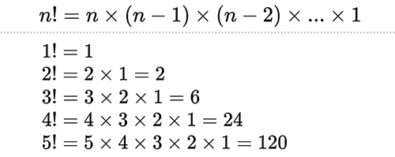
Factorial Formula

Slide 24
Problem-6
Write a function that will take an array and will return odd sum and even sum.
Input | Output
[ 3, 5, 8, 4, 25, 12] | Odd sum = 33, Even sum= 24

Slide 25


Do you have any questions?
Send it to me! I hope you learned something new.

Slide 26
Practice problems
Write a function that will take a number and will check the number is positive or negative.
Write a JavaScript function that accepts a number as a parameter and check the number is prime or not.
Write a function named findArea() that will take base and height of a triangle and will return the area of triangle.
Write a function named findArea() that will take height and width of a rectangle and will return the area of rectangle.
Write a function which will take an integer and will return the square of a number.
Write a function that will taka an array and calculate the sum of odd numbers greater than 10 and less than 50.

Slide 27

https://www.w3schools.com/js/js_functions.asp
https://www.w3schools.com/js/js_object_definition.asp
https://contactmentor.com/js-function-exercises-solution/
https://www.tutorialspoint.com/javascript/javascript_switch_case.htm
https://www.w3resource.com/javascript-exercises/
Resources
You can follow these links to learn more about functions, objects and problem solving.

Slide 28

Thank you!

